Slide 1
Single View Metrology
Computer Vision
Aarya | Panjak | Sohum
PhD22015 | PhD22007 | 2020339 (Undergrad)

Slide 2
Problem Statement
Given a single image with three vanishing points, we wish to perform the following:
Calibrate the camera - Figure out the intrinsic matrix
Generate a 3D model of the object of the scene.

Slide 3
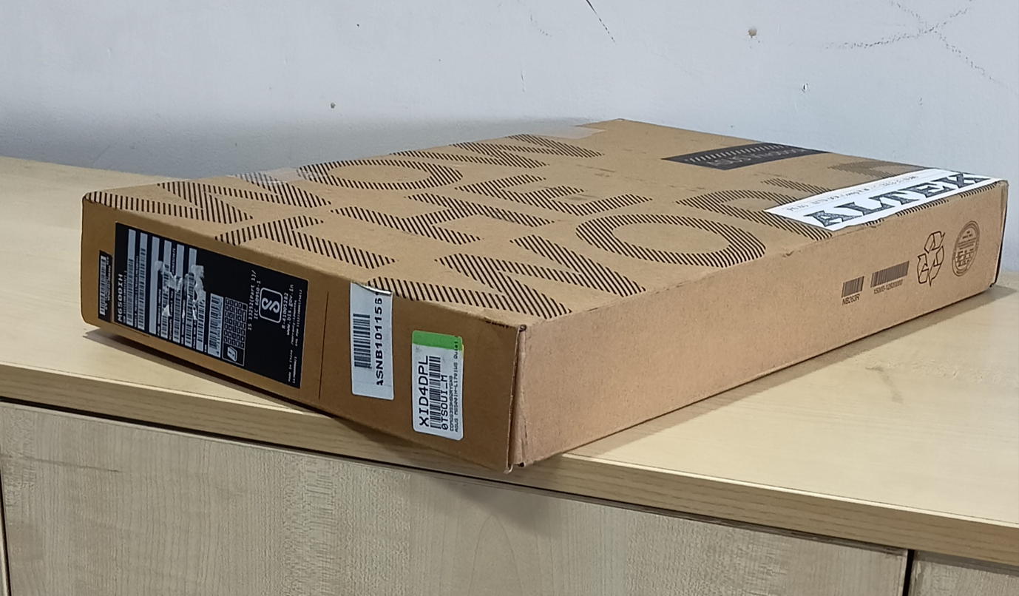
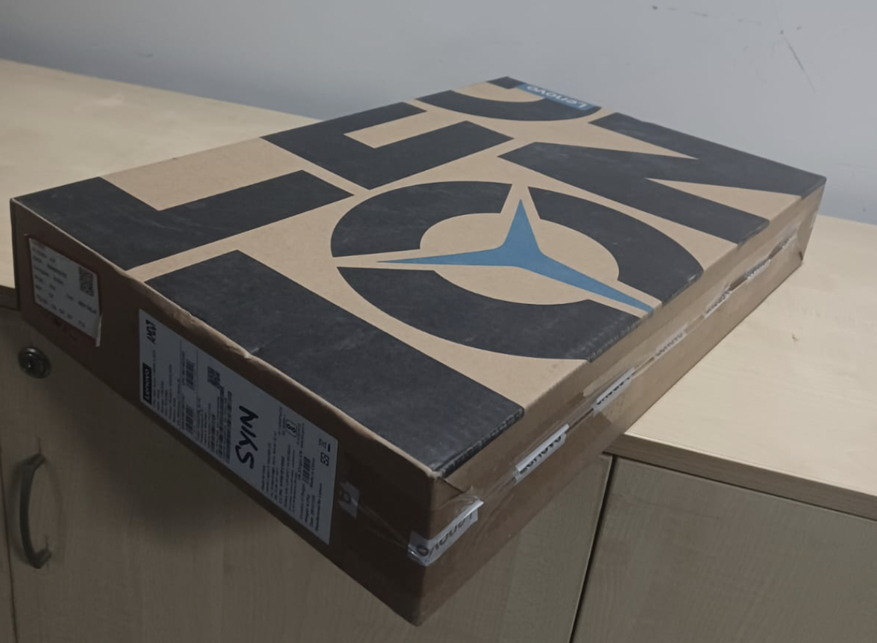
Images Used
The experiment was tested on two images which where taken by us.
fx = fy = 4.6 mm

Slide 4
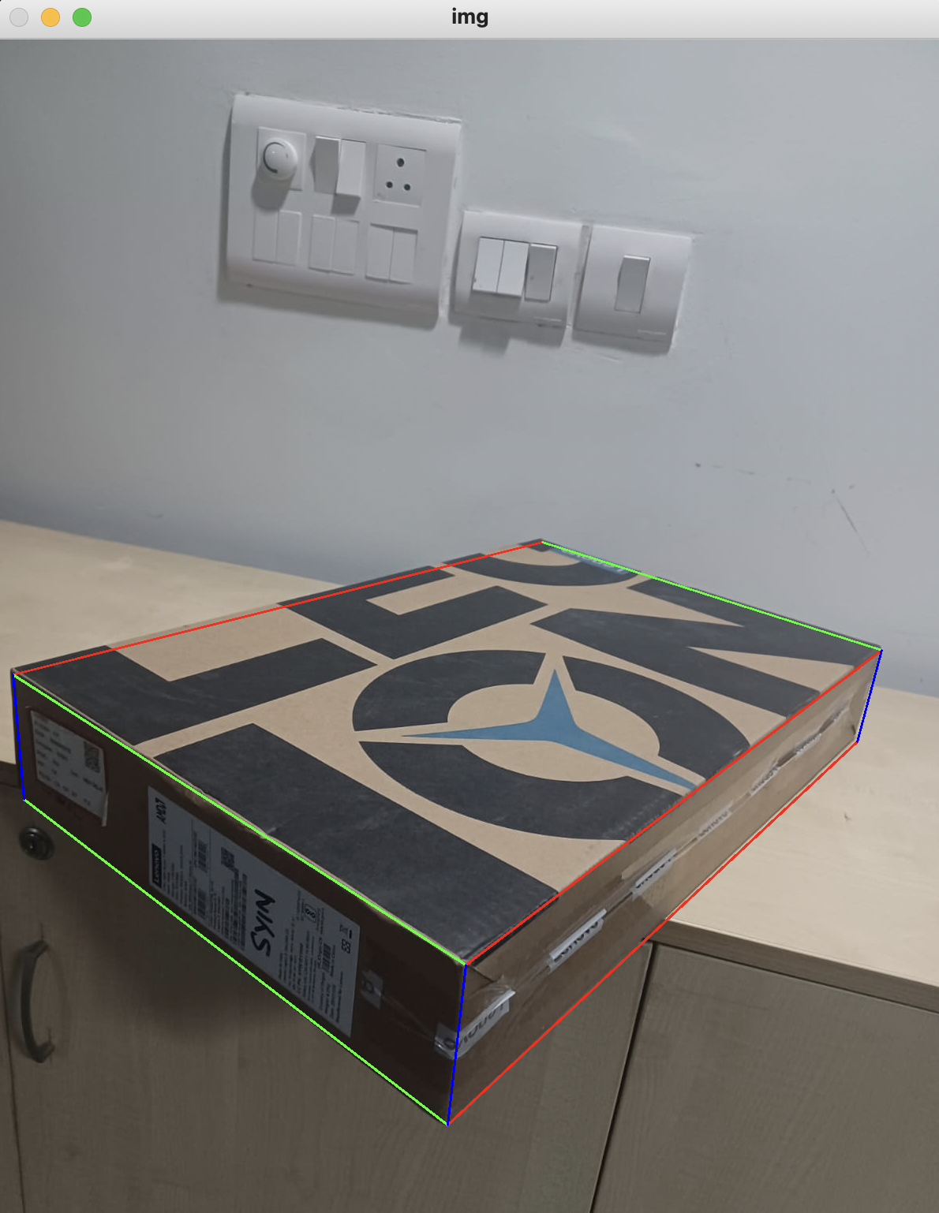
Setup - Calibration
Our pipeline requires an image path, running that we get an image window opened by openCV. The user is required to annotate the points joining which we get parallel lines intersecting at infinity. Closing the window we get another window showing us the lines.

Slide 5
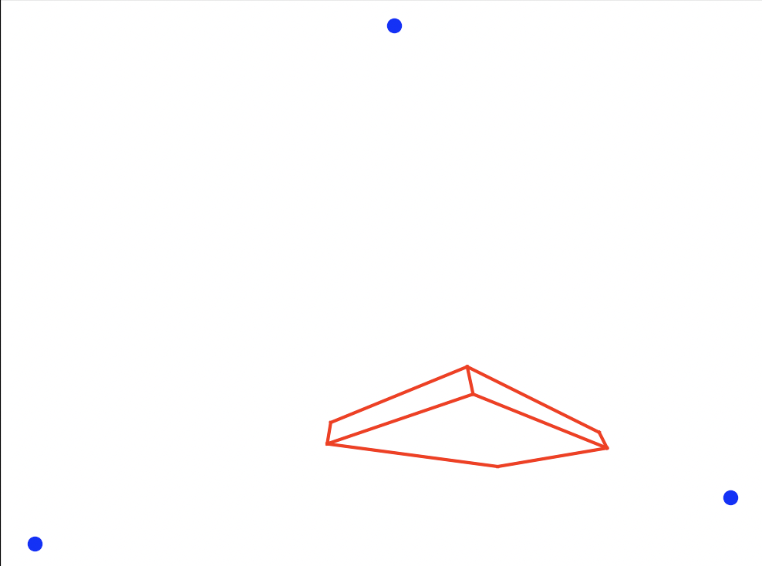
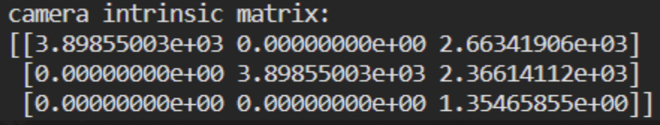
Calibration Process
First the lines are computed, then the 3 vanishing points are computed by finding the intersection between the 3 pairs of parallel lines. Which is visualized in the figure.
Now, given the three vanishing points p1, p2, and p3. We consider K to be intrinsic matrix, pci = K^-1 . pi
Then, pci^T . pcj = 0 = pi^T (K^-T.K^-1)pj, due to orthogonality and let (K^-T.K^-1) = w.
Now for the three sets of equation generated, solve for w using a least square - SVD method, and then a cholsky decomposition recovers K.

Slide 6
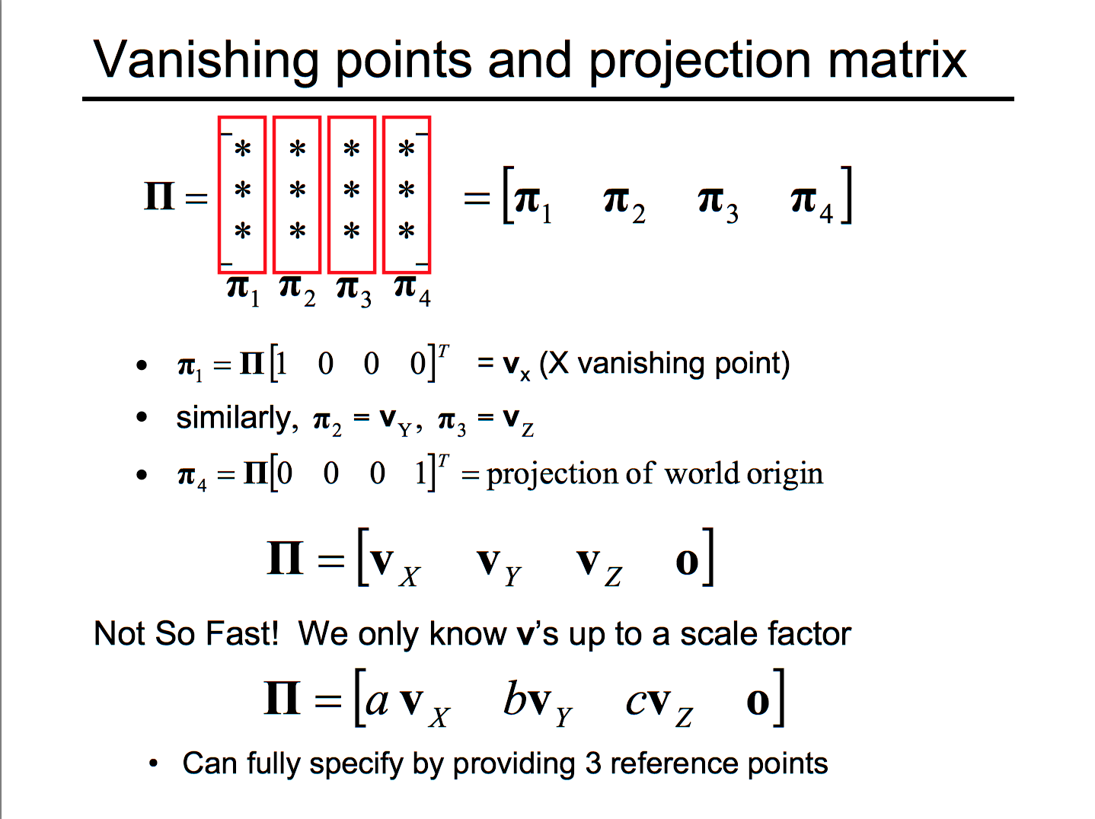
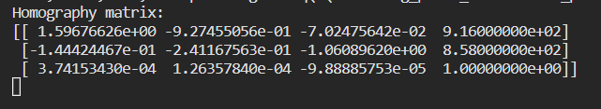
Projection Matrix Computation
Projection matrix is computed by taking the projective transformation of the world coordinates along the x, y and z axis.
These will map to Vx, Vy and Vz respectively.
So, our homography matrix will be [Vx, Vy, Vz, O].
The V’s are only upto scale, so we also need to find the scale factors.
To find, the scale factors, we need to take reference points along the x, y and z axis.

Slide 7
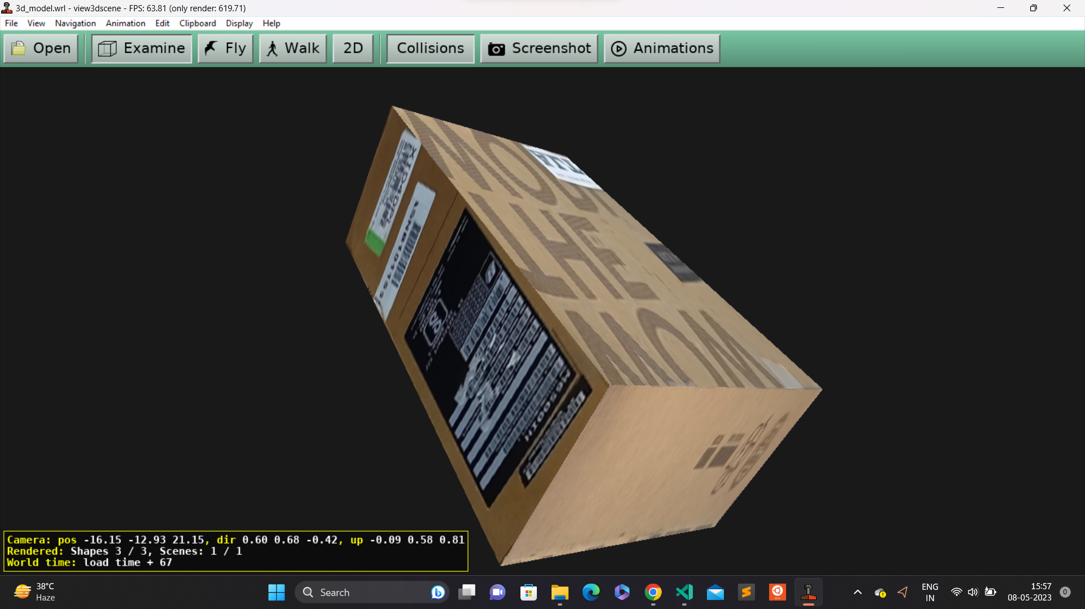
Result-3D model Output

Slide 8
Limitations and Future work
Our pipeline is set in a way that we require the top view or the bottom view of the object in concern because of how the lines are found, to mitigate this and make the system more robust, instead of manually annotating the lines we can use some line finding algorithm and then use the those set of parallel lines to find the vanishing points. Also, the we can see that even though we get a close enough focal length, it is has more error when compared to other methods which use multiple views to calibrate, this can be attributed to the fact that even the vanishing points are estimated and not exactly solved for which also accumulates the error.
Further this work can be used for more applications like estimating the height of the camera and other objects given a frame of reference.

Slide 9
Contribution
Aarya : Calibration, Model generation, Slides.
Pankaj : Calibration, Model generation, Slides.
Sohum : Calibration, Model generation, Slides.

